Slide 1
Numerical Analysis (5/7) Ordinary Differential equations
University of Luxembourg - 2024
Master in Mathematics
Hadrien Beriot

Slide 2
Outline
1. Introduction
2. Euler Methods
3. One step methods
4. Multi-step methods
5. Summary

Slide 3

1. Introduction

Slide 4
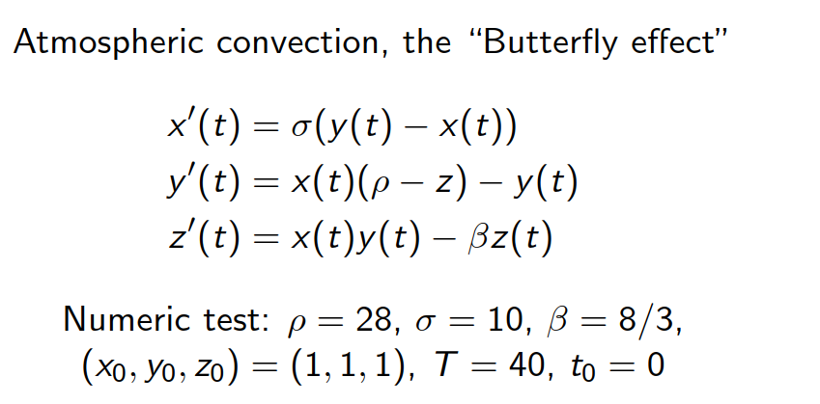
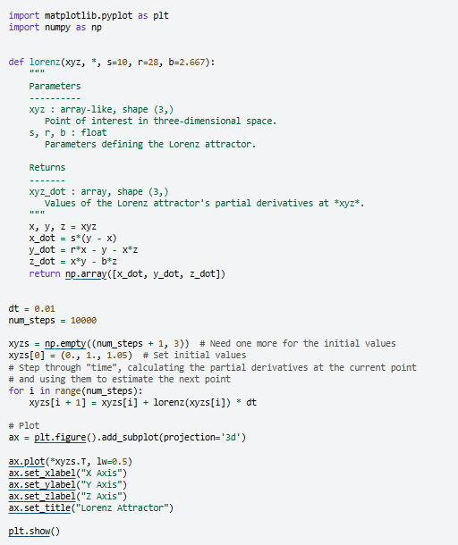
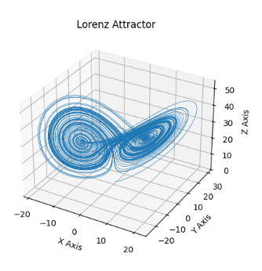
A famous example – The Lorenz system
https://matplotlib.org/stable/gallery/mplot3d/lorenz_attractor.html
Notes:
The image represents a Lorenz attractor, which is a three-dimensional chaotic attractor discovered by the mathematician Edward Lorenz.
The Lorenz attractor is a graphical representation of the solutions to a set of differential equations that describe a simplified model of atmospheric convection, known as the "Butterfly effect".
The image shows the characteristic butterfly-like shape of the Lorenz attractor, which demonstrates the sensitive dependence on initial conditions that is a hallmark of chaotic systems.

Slide 5
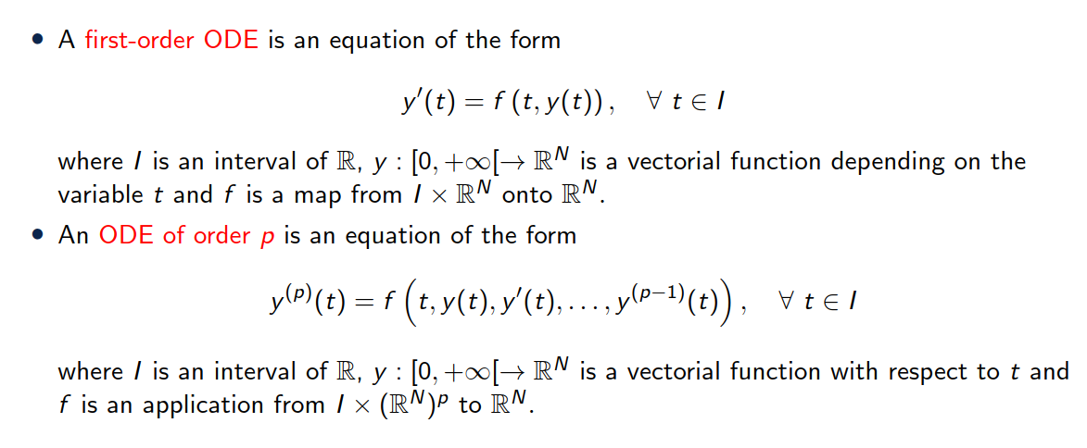
Definition

Slide 6
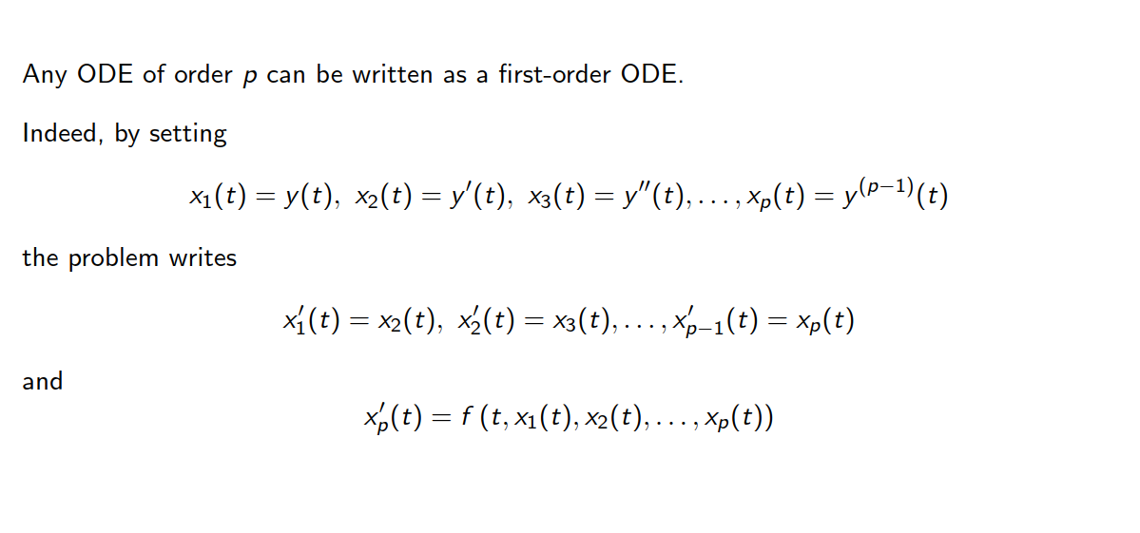
Remark

Slide 7
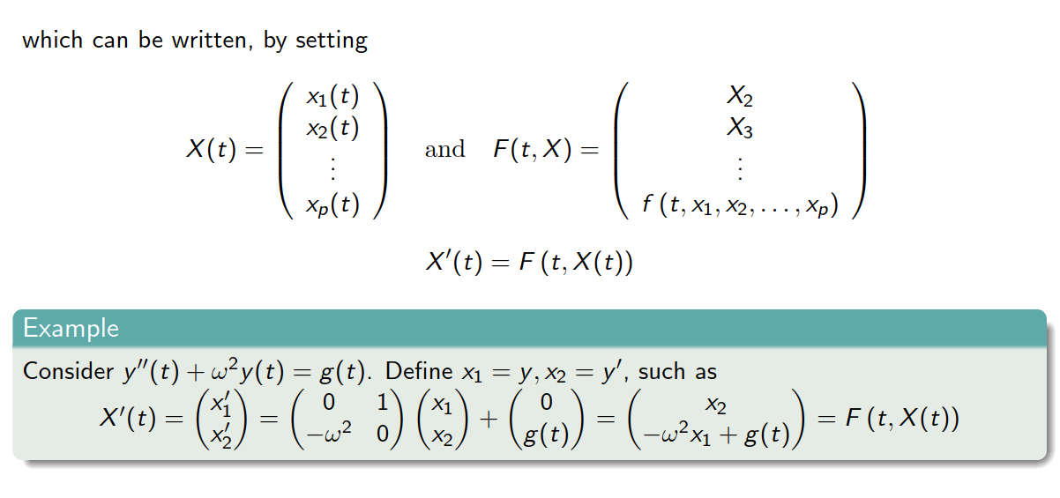
Remark

Slide 8
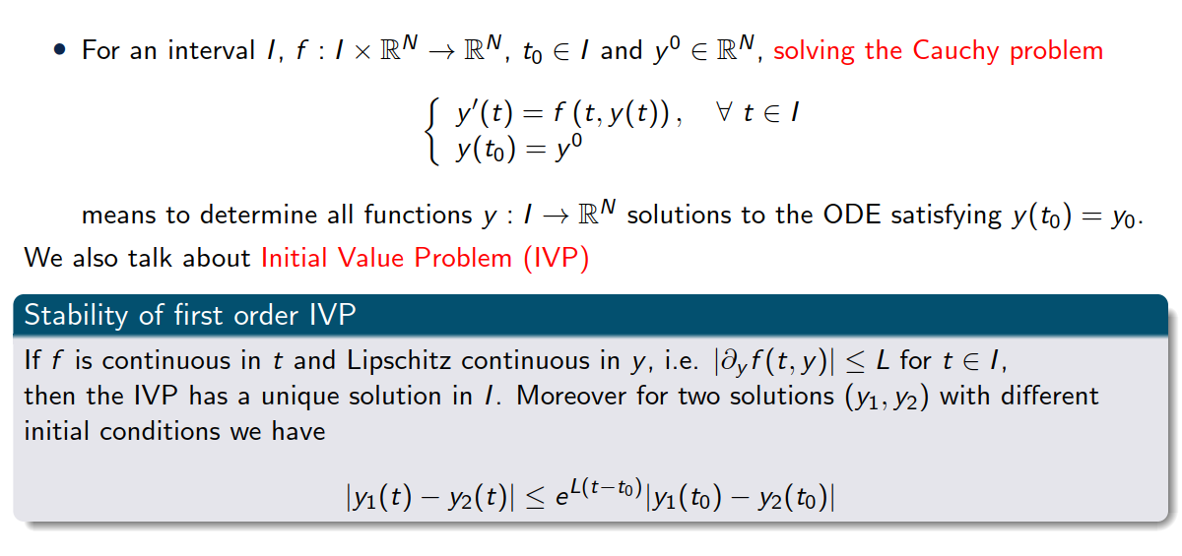
Definition – Initial Value Problem

Slide 9



Take away
Continuously differentiable
Lipschitz
Continuous
Continuous
Lipschitz ➔ limited in how fast in can change (bounded derivative)
$f(t,u)$ continuous in $t$
$f(t,u)$ Lipschitz continuous in $u$

Slide 10
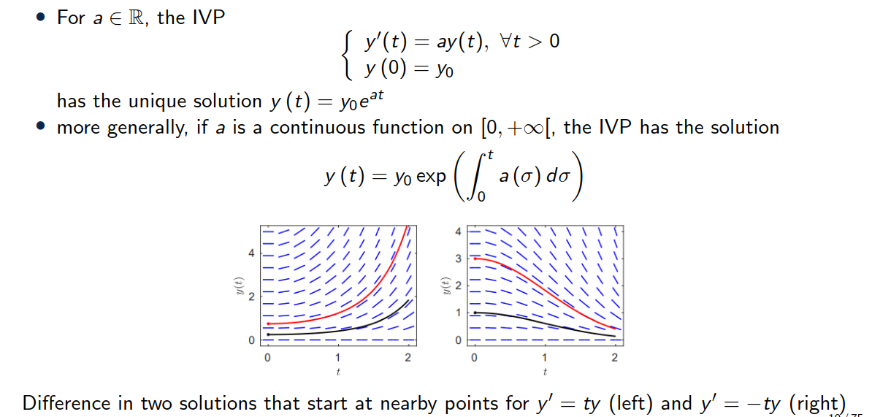
A simple example

Slide 11
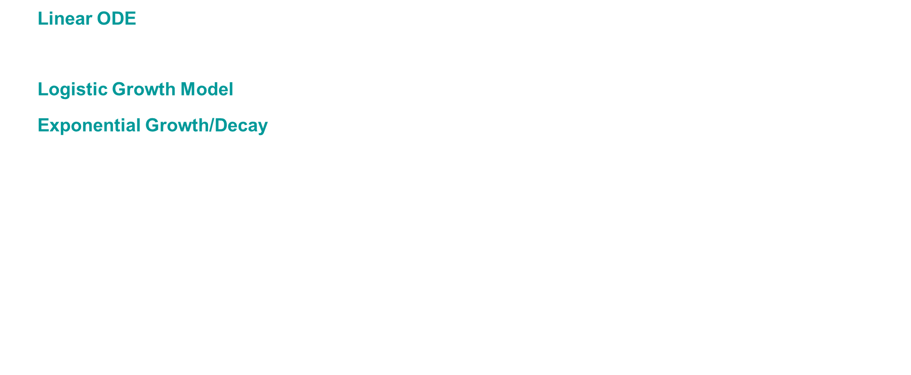
Examples of ODEs
Linear ODE: $u′ = −2u$ $⇒$solution is $u(t) =C_{0}e^{−2t}$
Separable ODE: $u′ = u²$ $⇒$solution is $u(t) = 1 / (C₀ − t)$
Logistic Growth Model: $u′ = u(1 − u)$ $⇒$solution is $u\left(t\right)=C_{0}e^{t}/\left(1 +C_{0}e^{t}\right)$
Exponential Growth/Decay: $u^{′}= −ku⇒$ solution is $u(t) =C_{0}e^{−kt}$
Harmonic Oscillator: $u′′ = −ω²u$, solution is $u(t) = C₁cos⁡(ωt) + C₂sin⁡(ωt)$

Slide 12
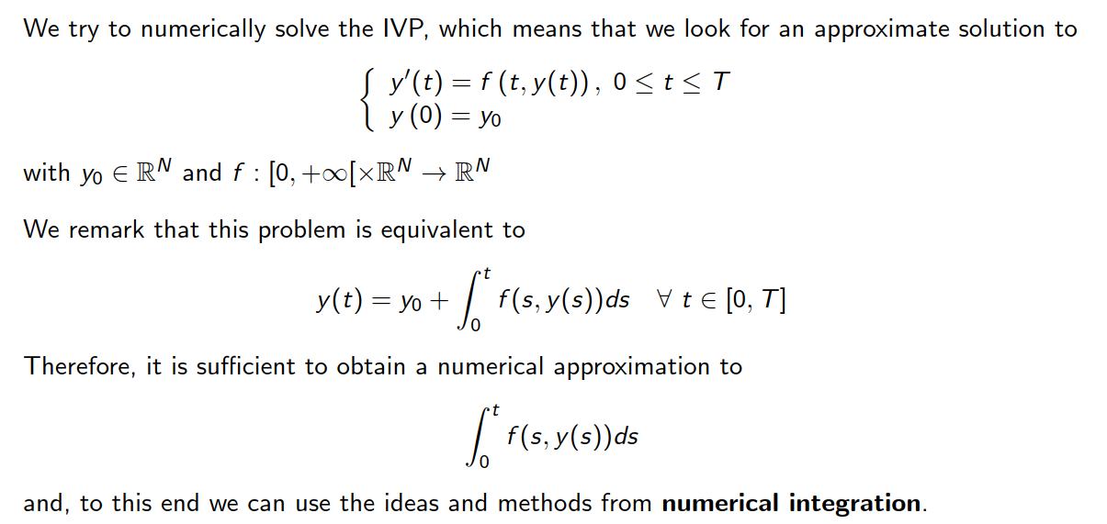
Numerical approximation

Slide 13
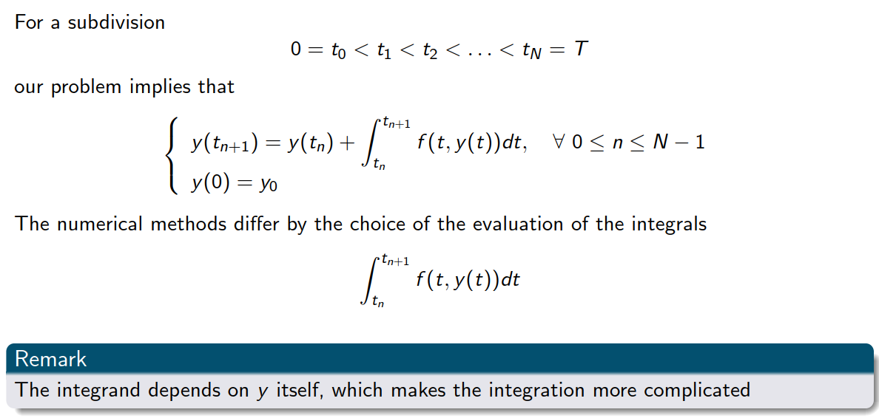
Numerical approximation

Slide 14
2. Euler Methods

Slide 15
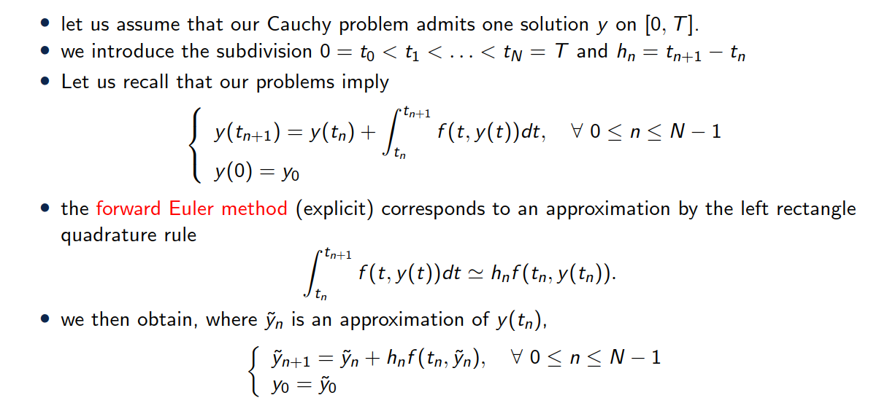
The forward Euler problem

Slide 16
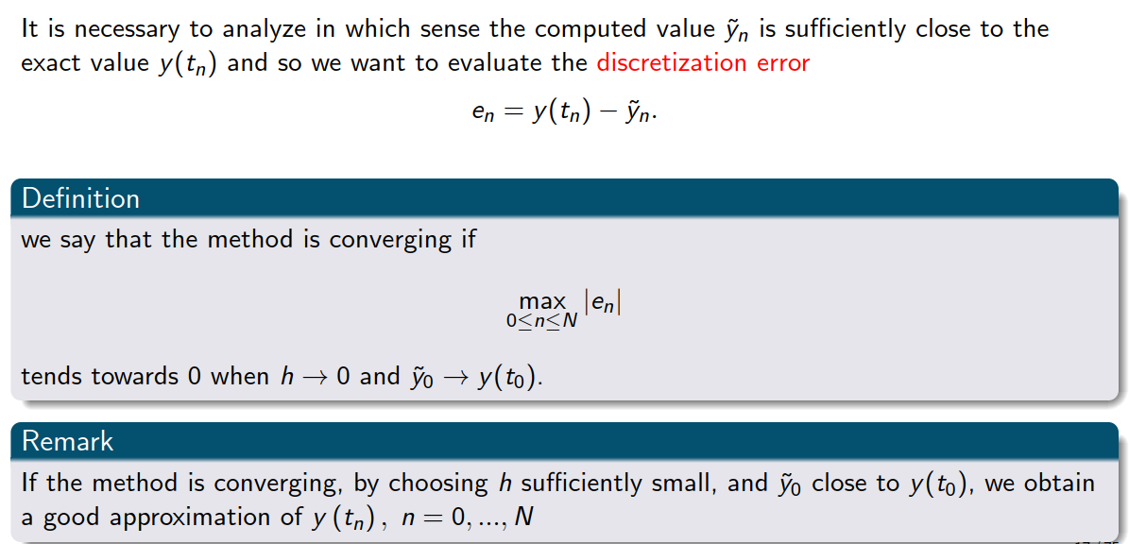
Convergence

Slide 17
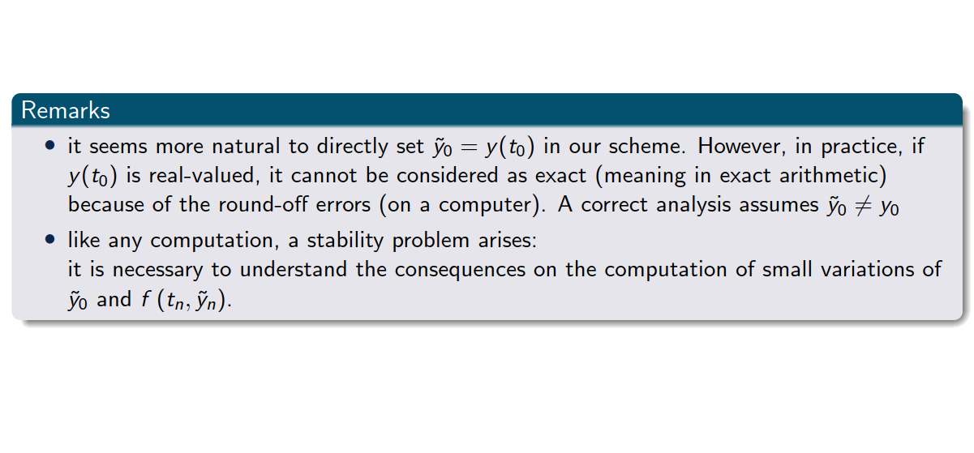
Convergence

Slide 18
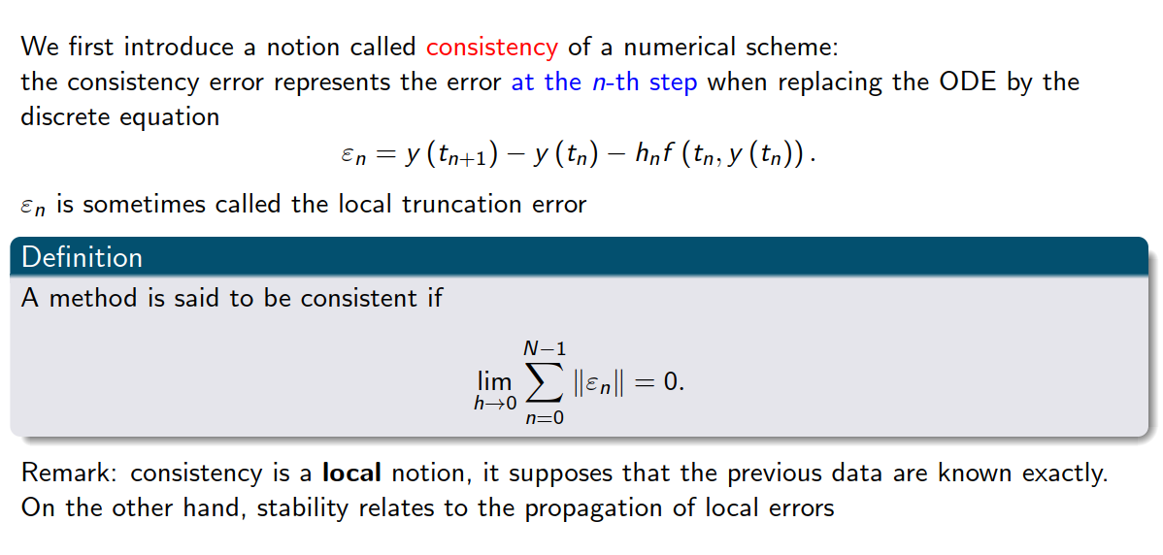
Consistency

Slide 19
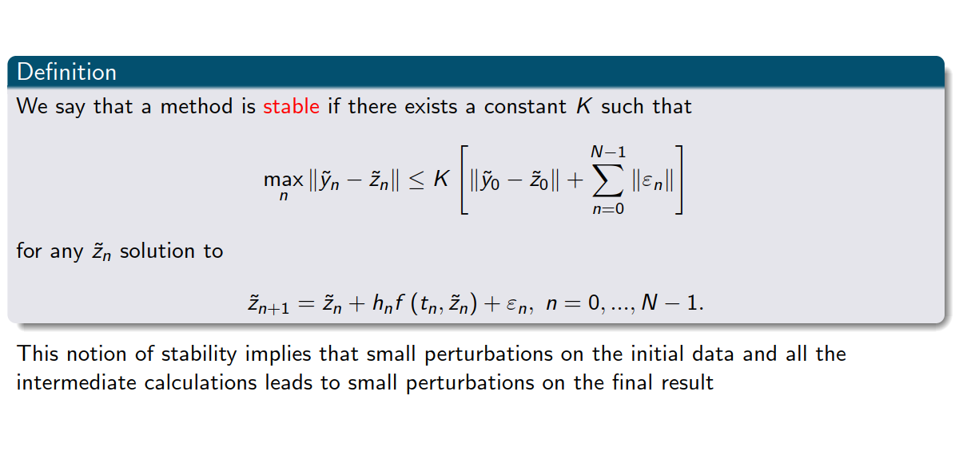
Stability

Slide 20
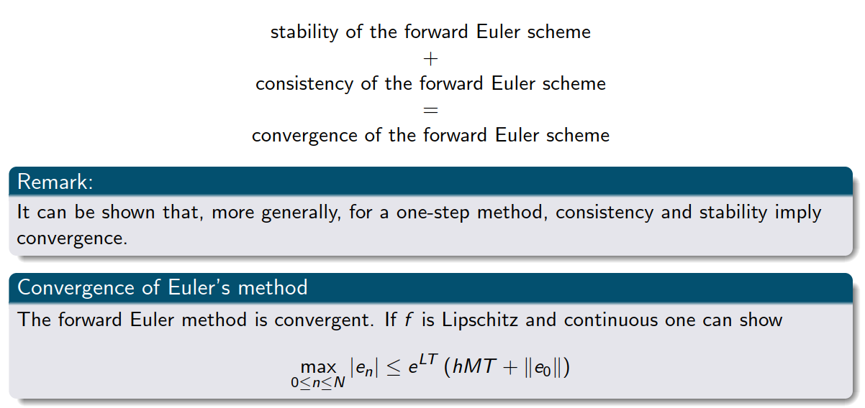
Back to convergence

Slide 21
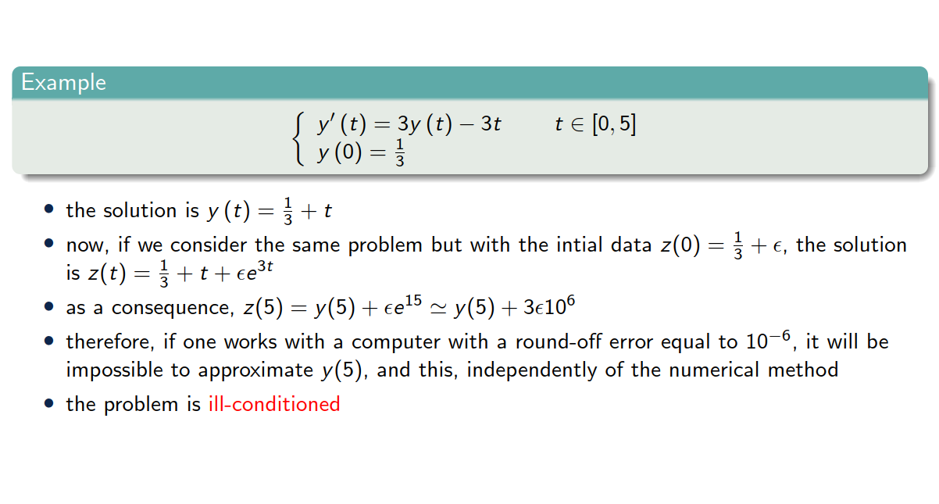
Example 1

Slide 22
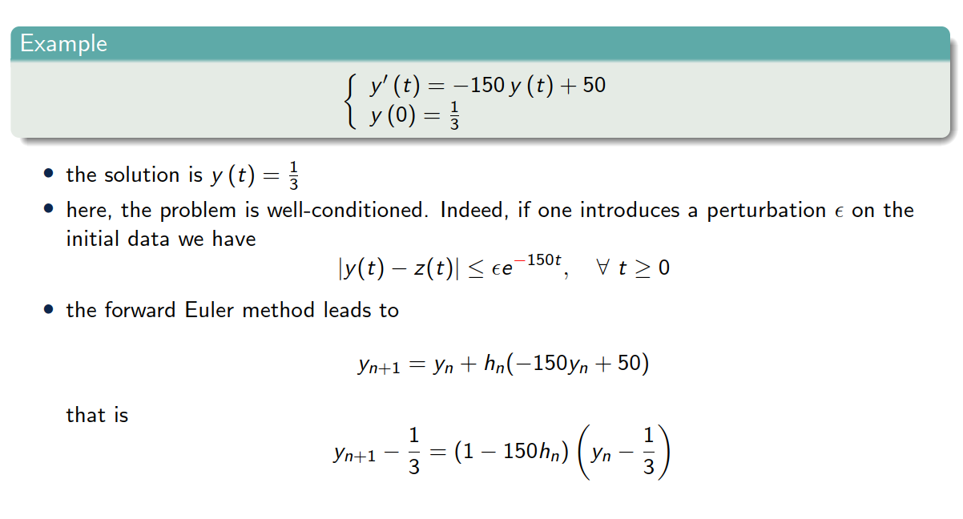
Example 2

Slide 23
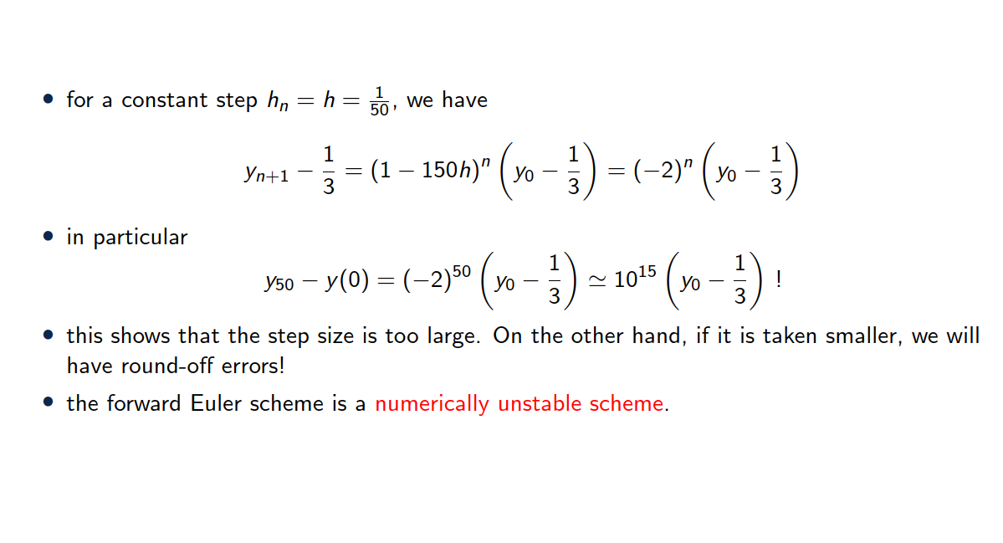
Example 2

Slide 24
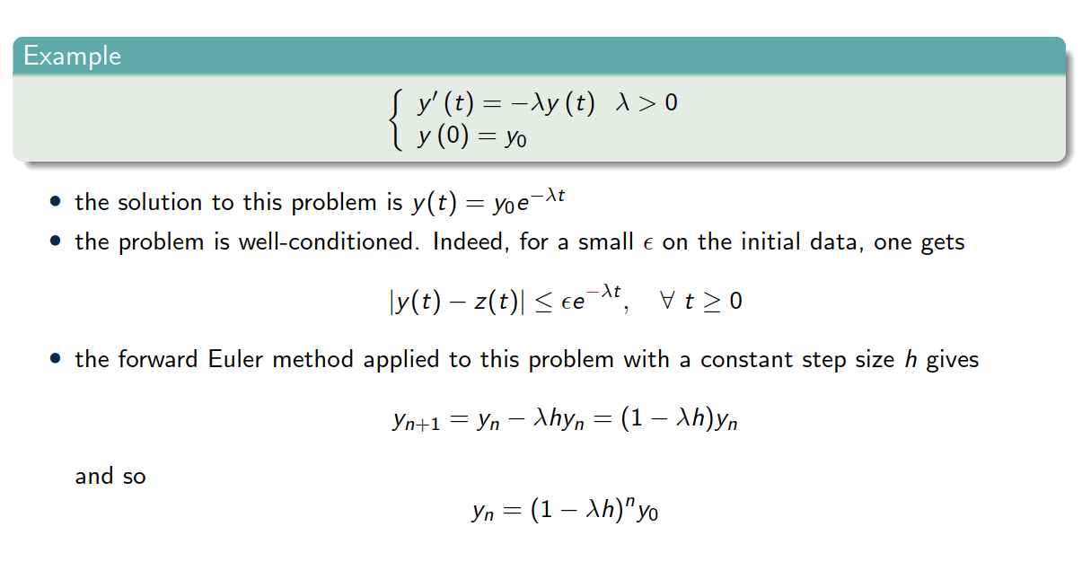
Example 3

Slide 25
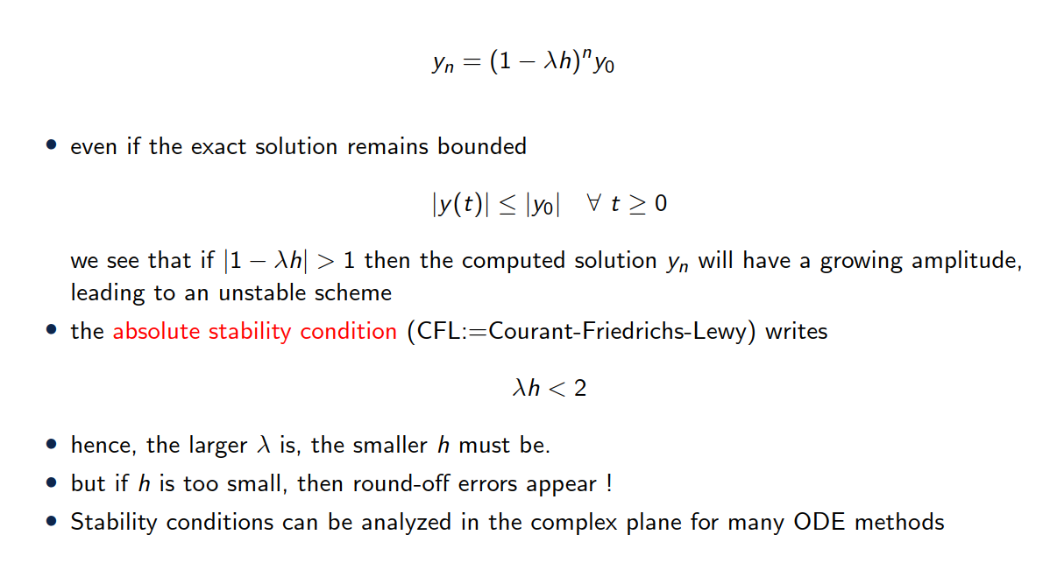
Example 3

Slide 26
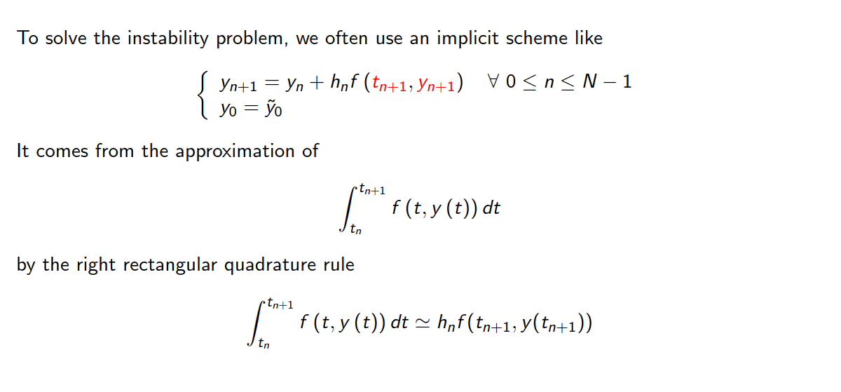
Backward Euler (implicit)

Slide 27
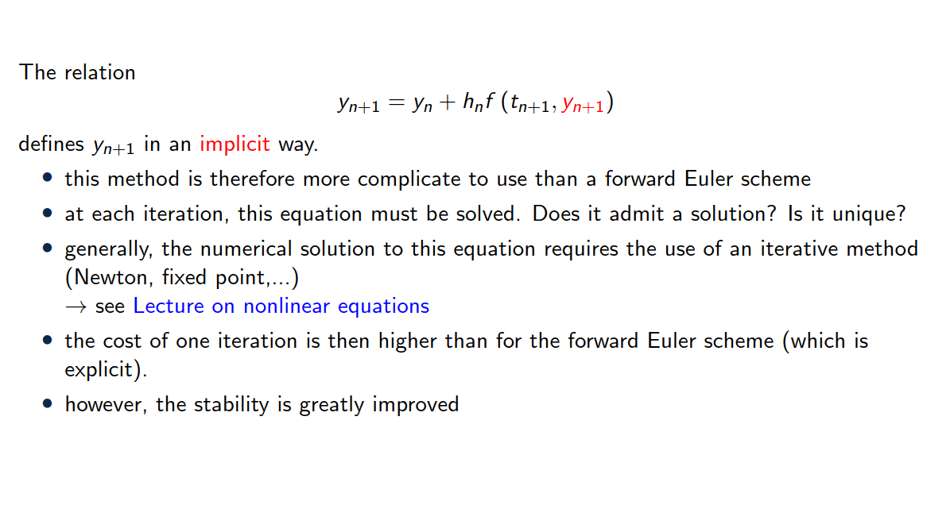
Backward Euler (implicit)

Slide 28
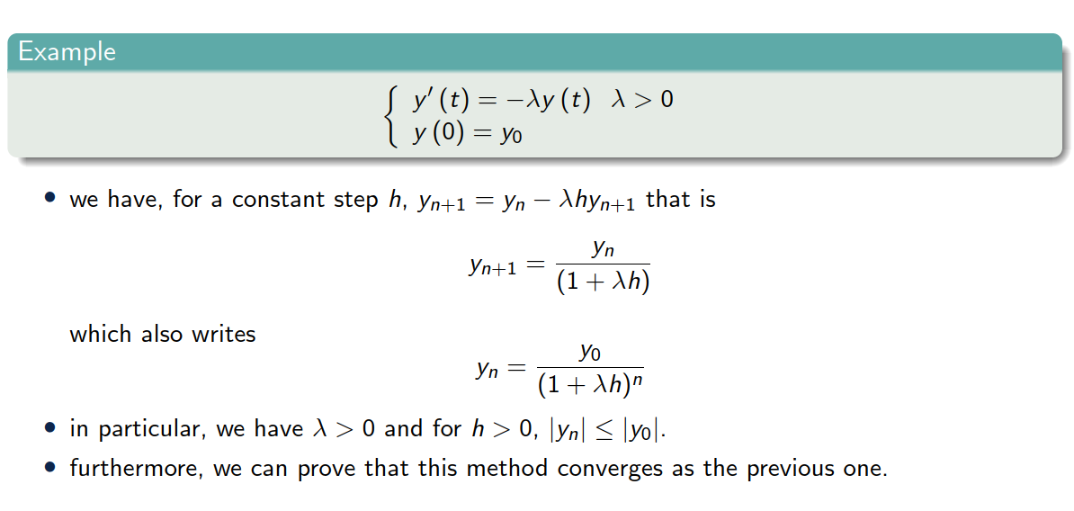
Back to example 3

Slide 29
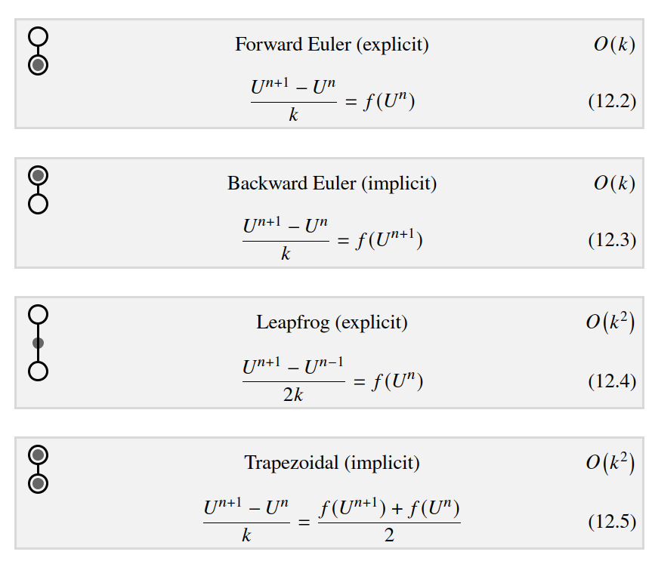
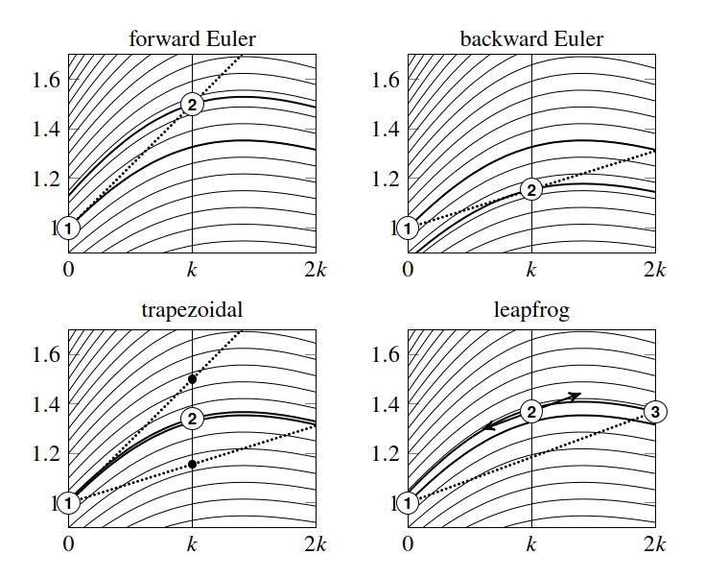


Single step methods
Integral curves
Exercise 1

Slide 30
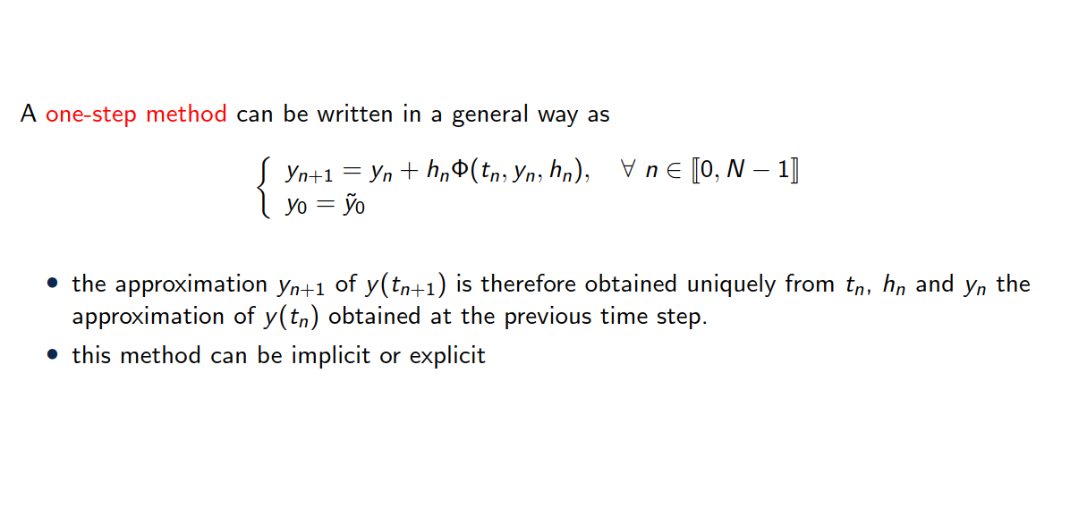
General study of one-step methods

Slide 31
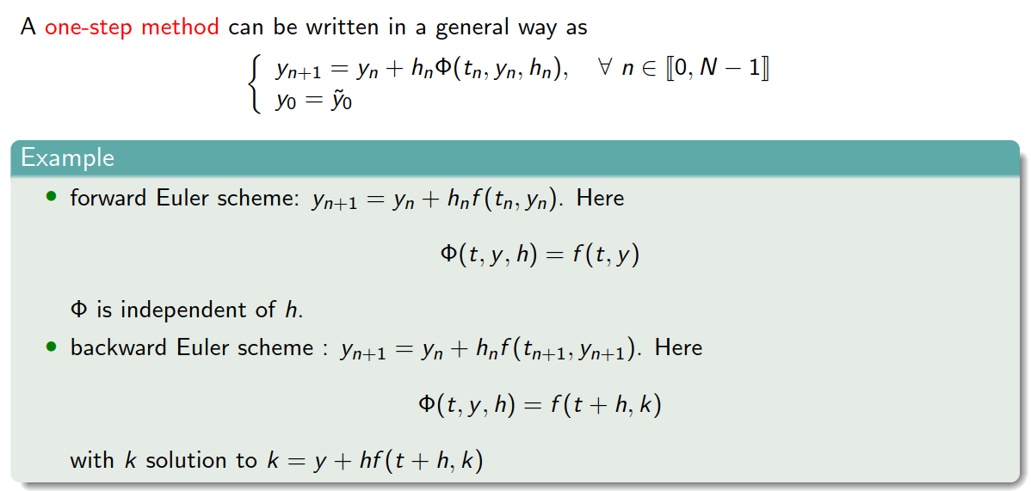
General study of one-step methods

Slide 32
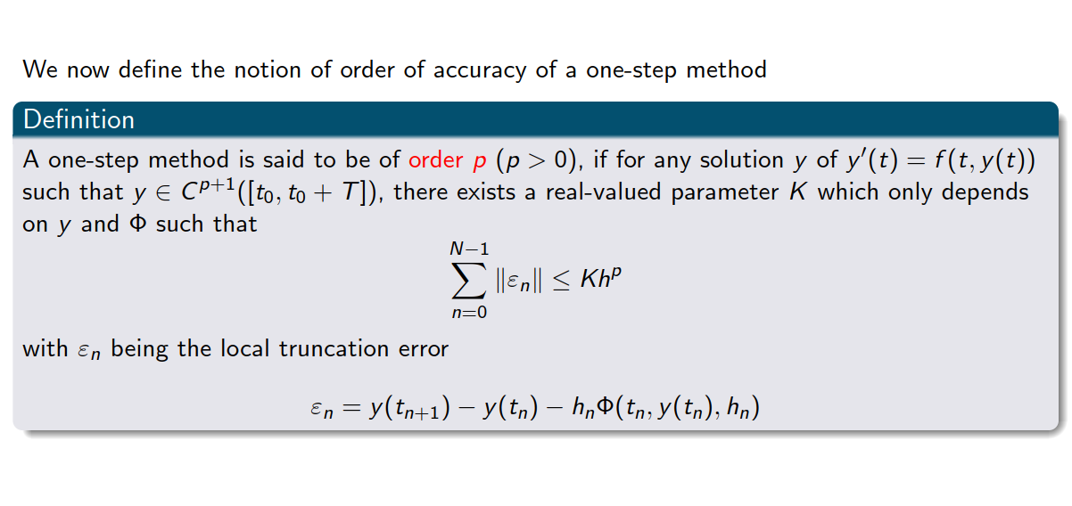
Order of accuracy

Slide 33
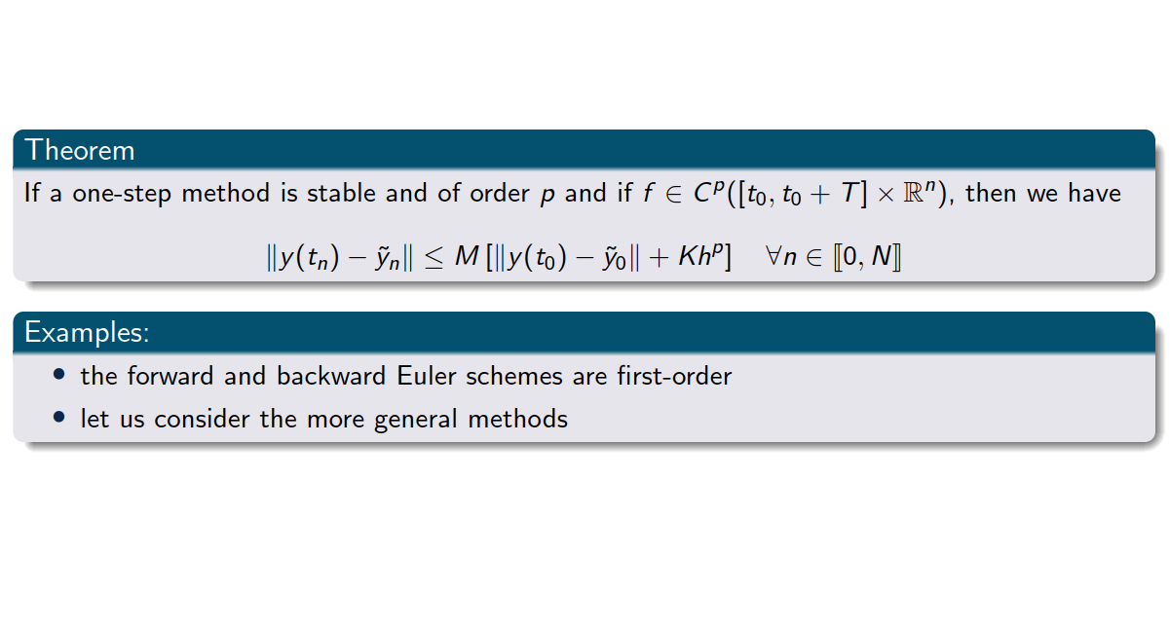
Order of accuracy
Exercise 2

Slide 34
3. Runge Kutta methods

Slide 35
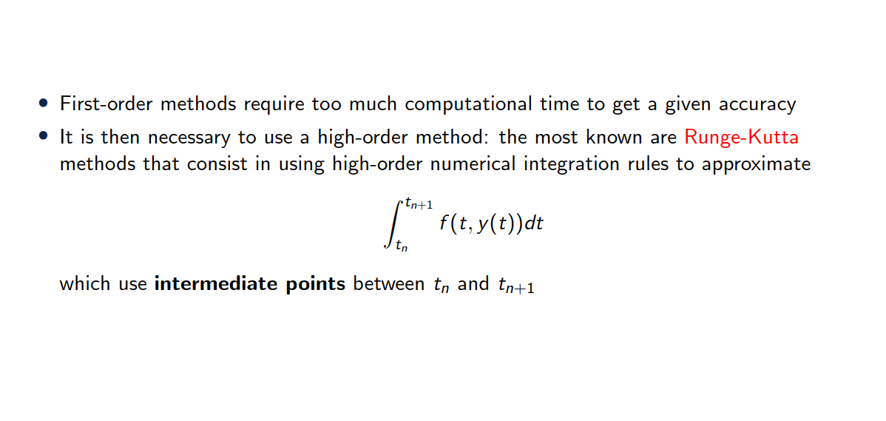
Runge-Kutta methods

Slide 36


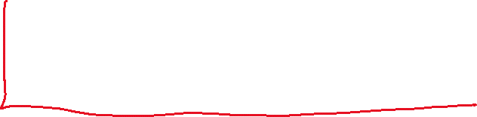


Idea = integrate the ODE + use quadrature

Slide 37











Idea = integrate the ODE + use quadrature

Slide 38





Idea = integrate the ODE + use quadrature

Slide 39
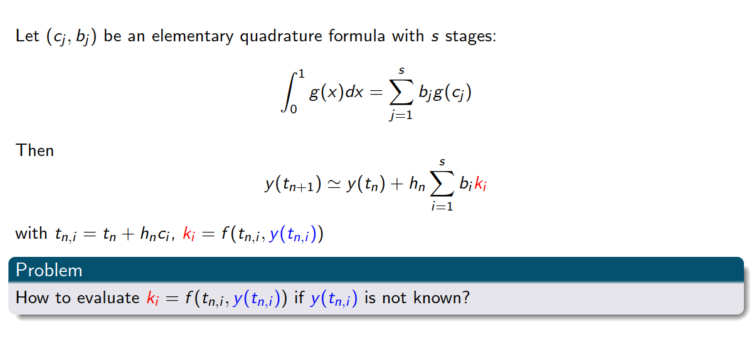
Runge-Kutta methods

Slide 40
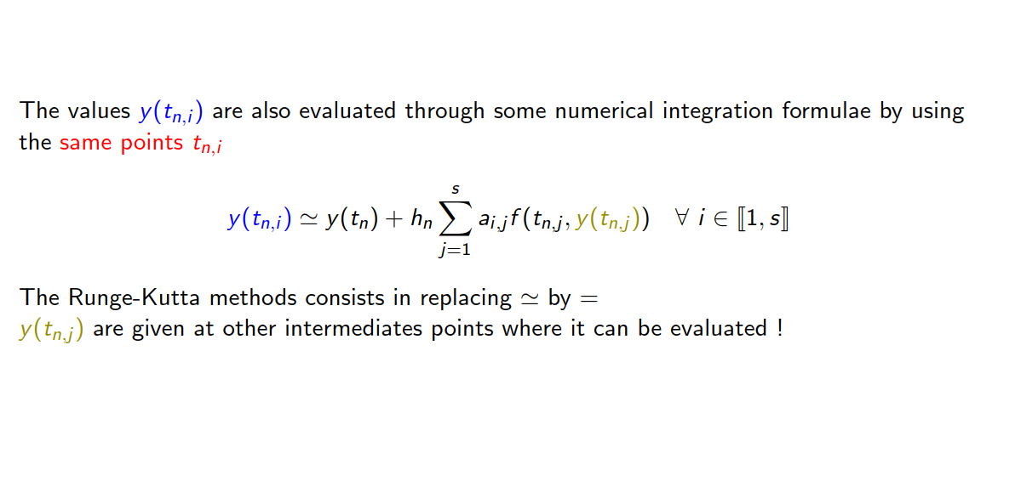
Runge-Kutta methods

Slide 41
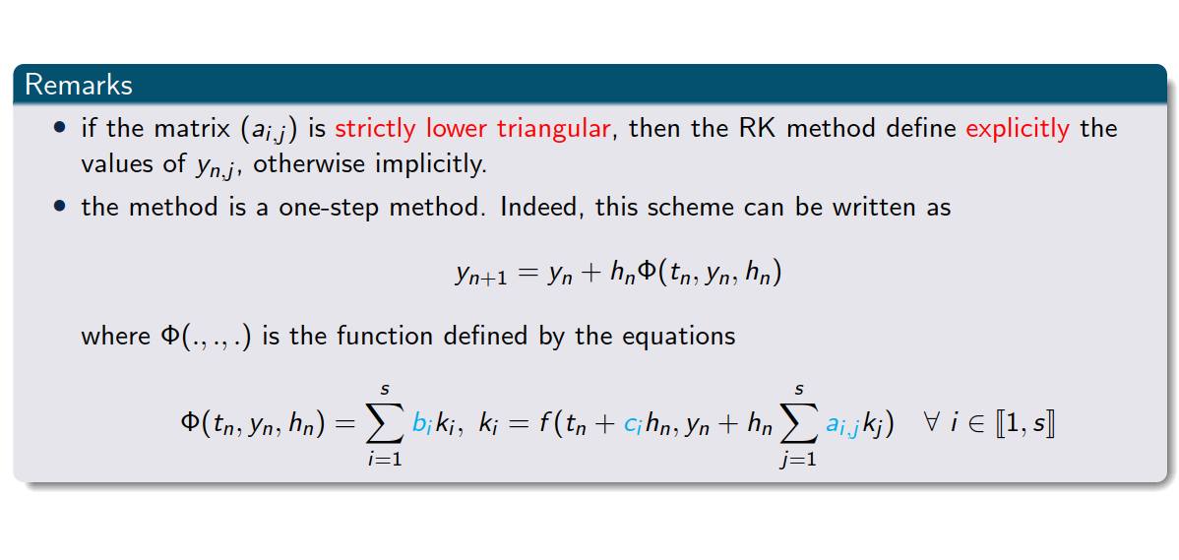
Runge-Kutta methods

Slide 42
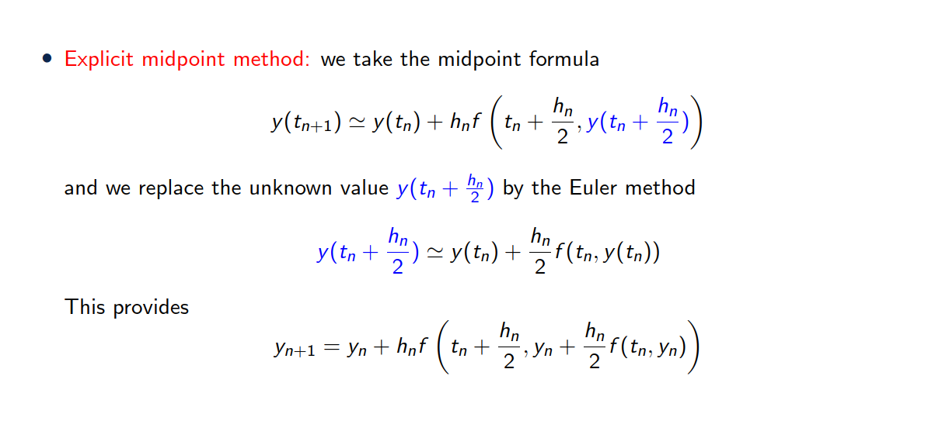
Examples of Runge Kutta method

Slide 43
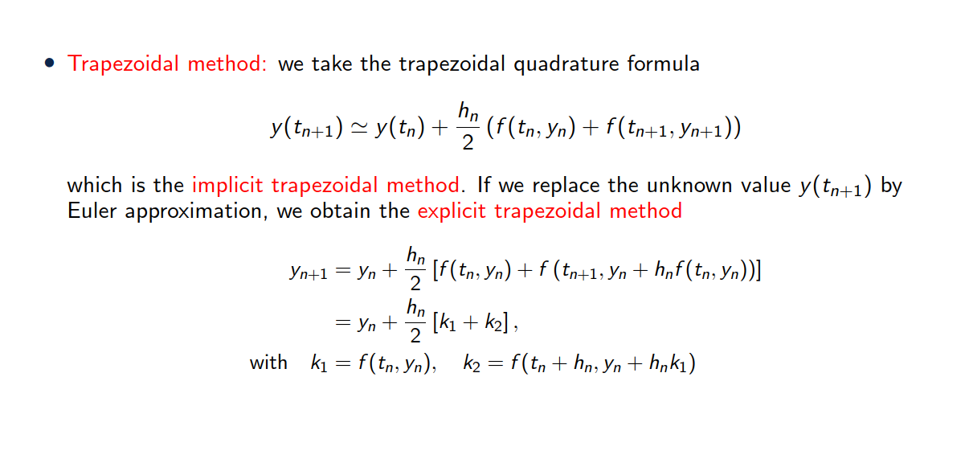

Examples of Runge Kutta method

Slide 44

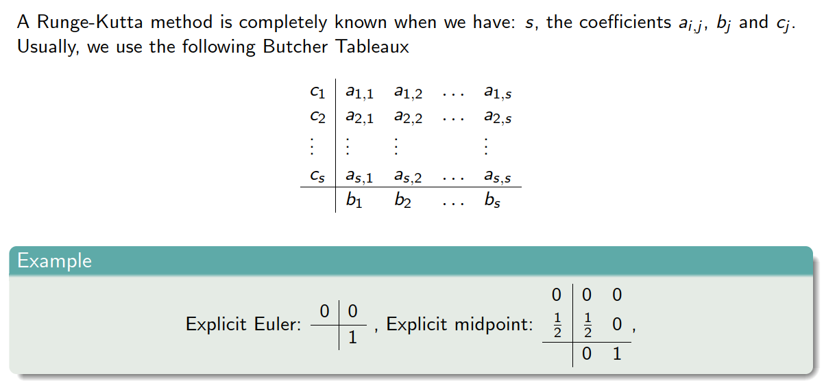




Butcher Tableau

Slide 45
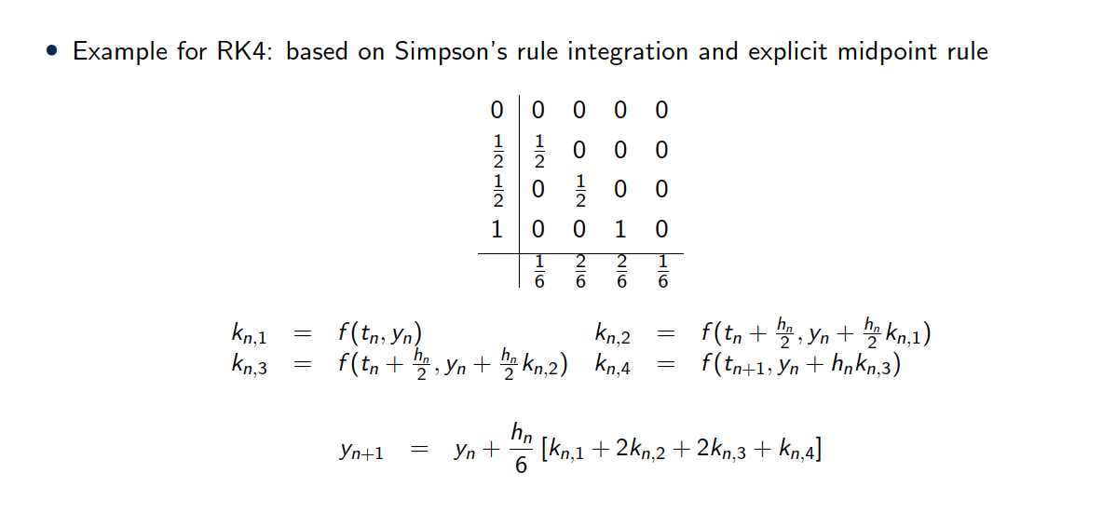


Runge Kutta 4 (RK4)

Slide 46
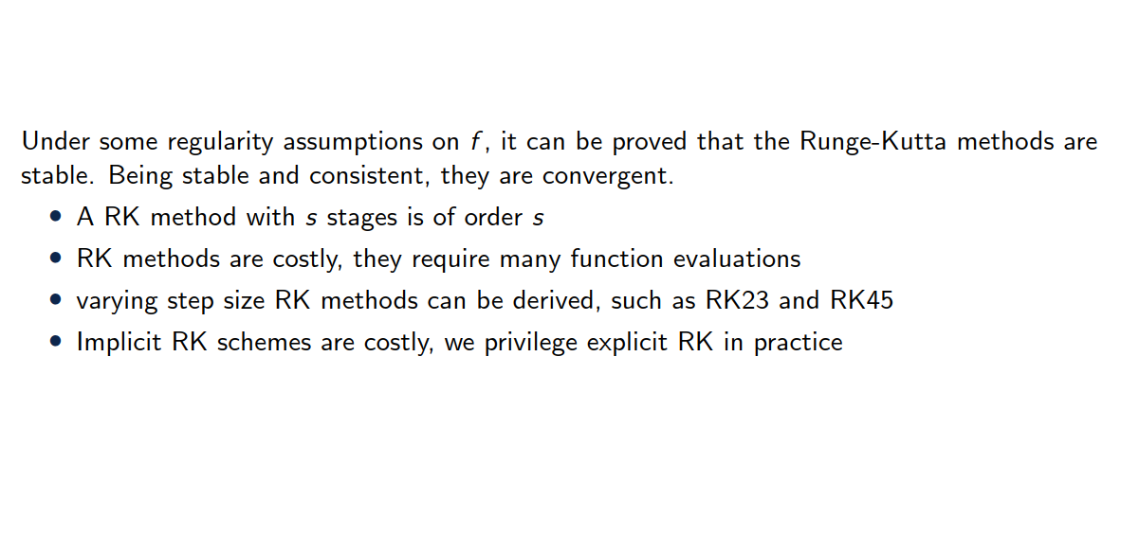
Remarks on Runge Kutta

Slide 47
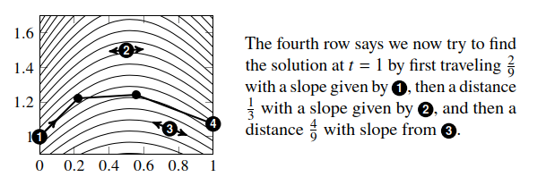
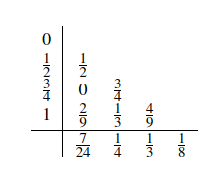
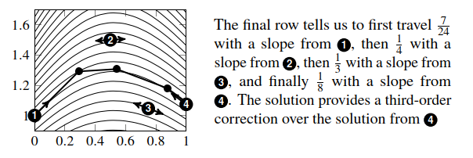















Butcher Tableau - interpretation

Slide 48
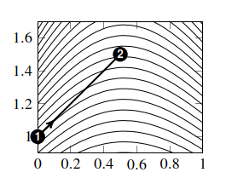
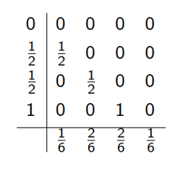

























RK4 - interpretation

Slide 49















RK4 - interpretation

Slide 50
5. Summary

Slide 51
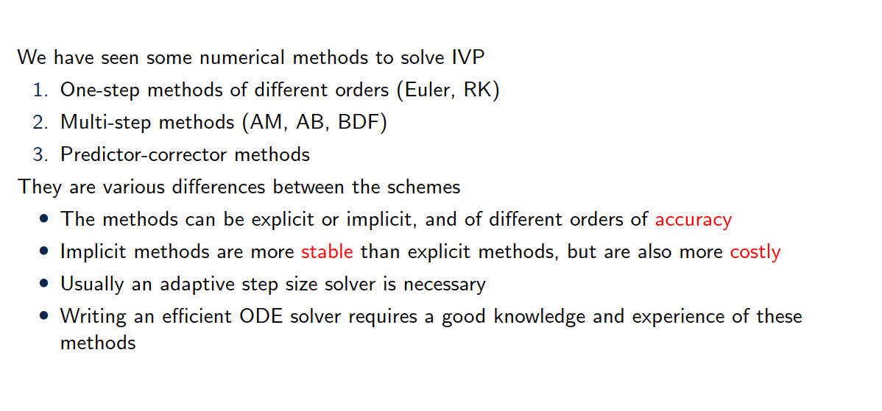
Summary

